Slide 1
Contents:
Introduction
Compress dataframe
DB integration
Decompression
Performance - Guerilla vs TimescaleDB
Batch process - Validation Manager
Batch process - Append data
Data Features
Guerilla vs other compression algorithms

Slide 2
1) Introduction
Guerilla Compression is a python library that allows efficient data compression and storage tailored specifically to financial timeseries data. Although it is centered around the lossless compression functionality, it can also prove useful in the overall workflow of data validation in the process of appending data, as well as in targeted querying for the purpose of generating and backtesting trading strategies.
The name guerilla itself is both a play on one of the most popular timeseries compression algorithm - Gorilla, introduced by Facebook and used in some of the most popular compression software, as well as a testament to the way the compression algorithm fights ferociously for performance on both storage and compute fronts.

Slide 3
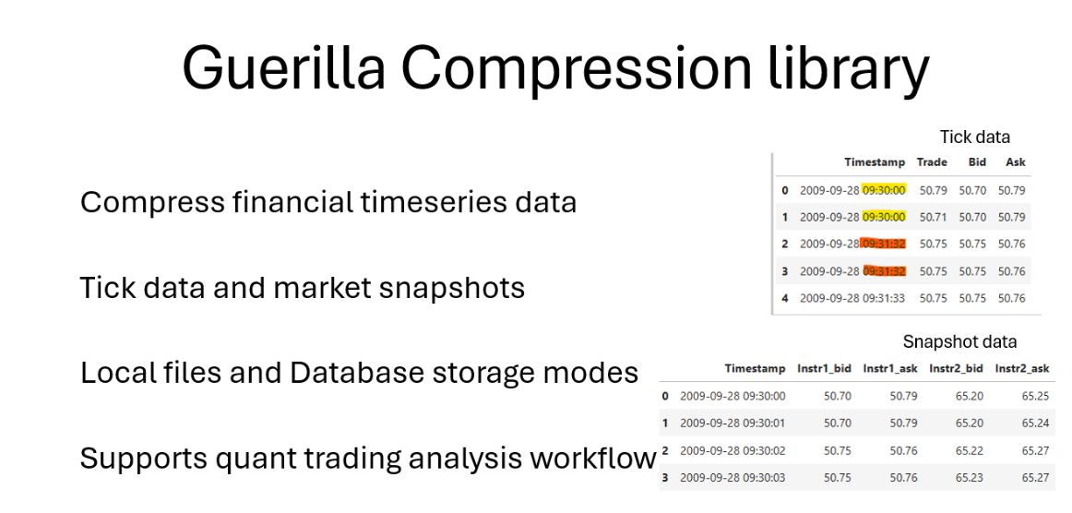

Slide 4
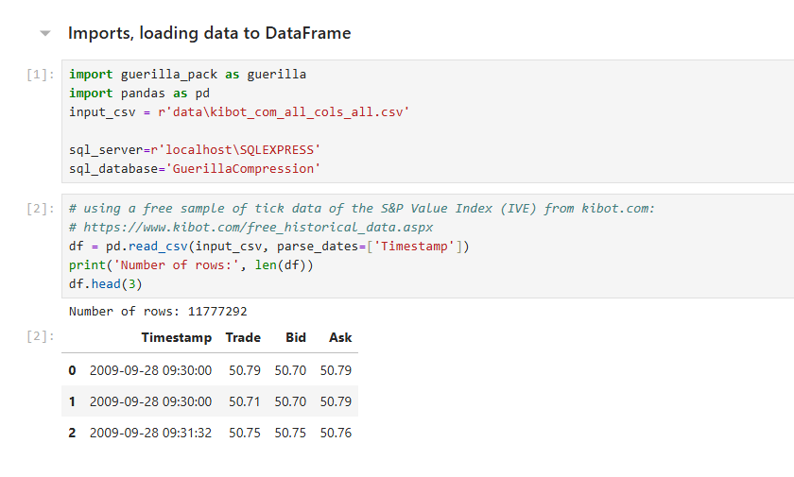

Slide 5
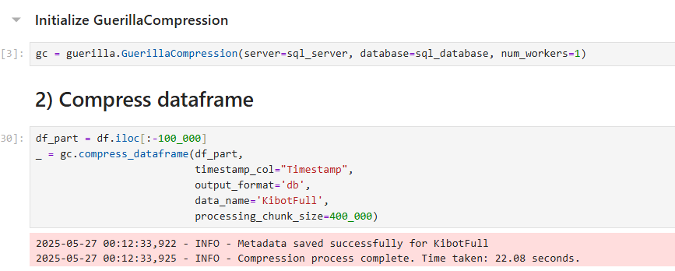
Guerilla supports multiprocessing, although there is some overhead due to starting time of child processes. This overhead fades with larger datasets and the performance improvement is more profound. Here the improvement in data ingestion is 14.5 vs 22 seconds. This translates to throughput of 812k and 535k rows/sec.

Slide 6
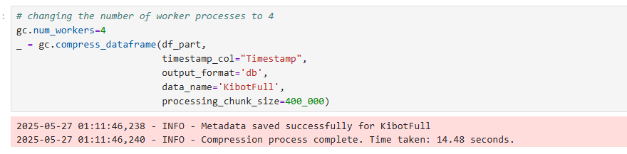
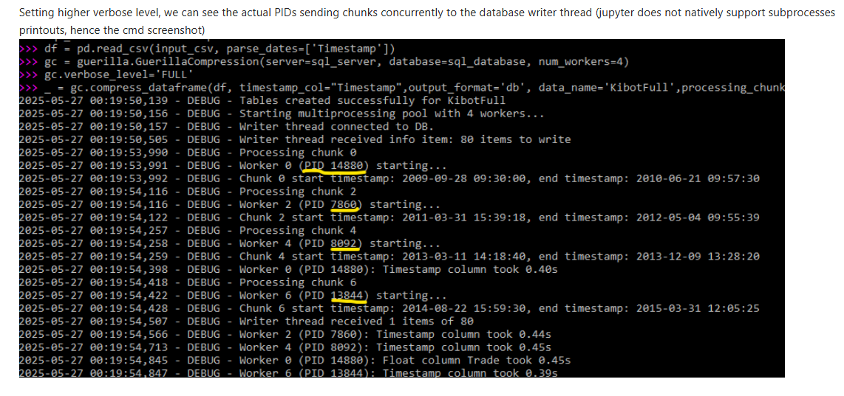

Slide 7
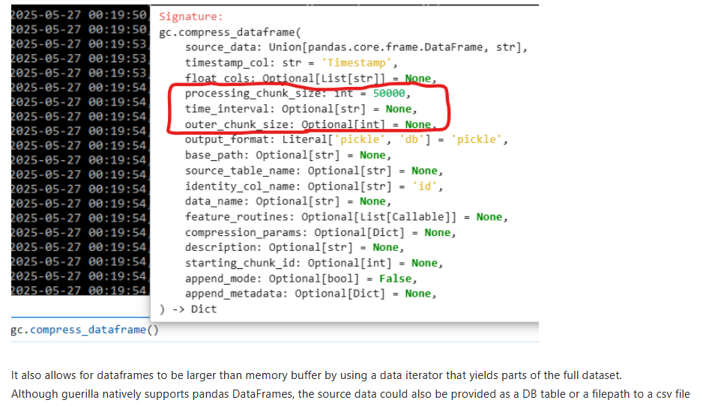
Chunk size
Guerilla - as most timesries databases - divides the full dataset into chunks because of more efficient retrieving data. It supports setting the chunk size both based on number of rows as well as a time interval.

Slide 8
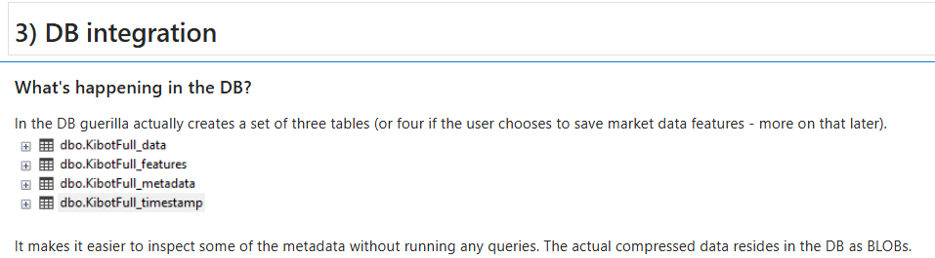

Slide 9
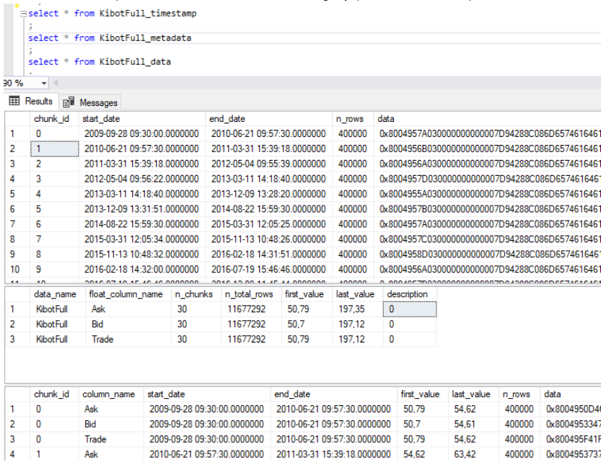

Slide 10
Organizing the data for many instruments/markets/asset classes
A logical approach could be to bundle together similar instruments under a dataname in the snapshot paradigm or use a unique id for every financial instrument in the tick data paradigm, as the tick data nature makes it harder for different instruments to be presented together.
To organize the data further, the user can of course use separate databases or schemas, for instance using spearate databases for separate asset classes and schemas for separate markets within an asset class.

Slide 11
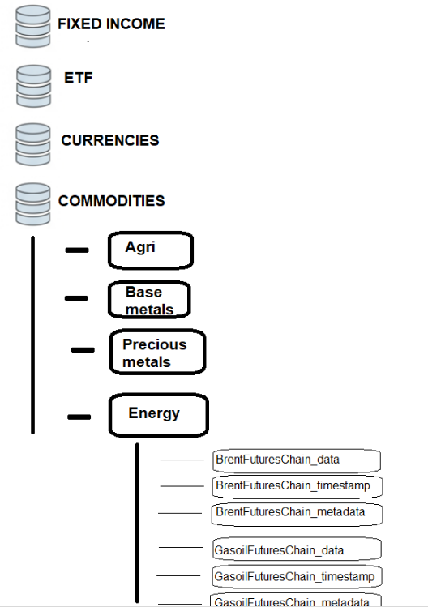

Slide 12
Dividing the full dataset into timestamps and other columns is a design choice that can be useful if the compressed data being stored is in the snapshot paradigm. Data chunks use a chunk_id that allows linking them to a timestamp chunk for more efficient storage of timestamps. Specifically, if there are a lot of snapshot data with the same trading hours and sampling frequency, saving the timestamps for each of the instruments separately translates into a huge waste of storage.
The timestamp id can mitigate some of this waste, depending on the specific setup.
The performance showcased in this presentation does not take advantage of this behaviour, as there is only one instrument presented in the demo and its prices are provided in the tick data paradigm. Hence taking this into consideration for real world scenarios the performance could still be improved.

Slide 13
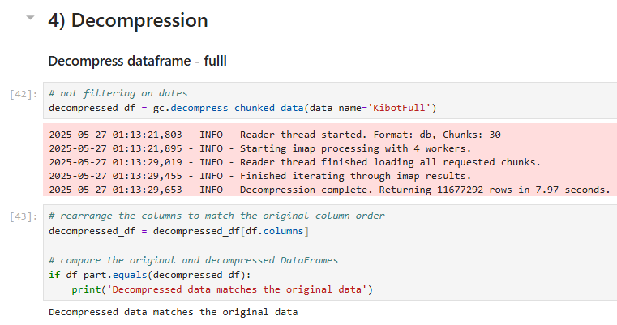

Slide 14
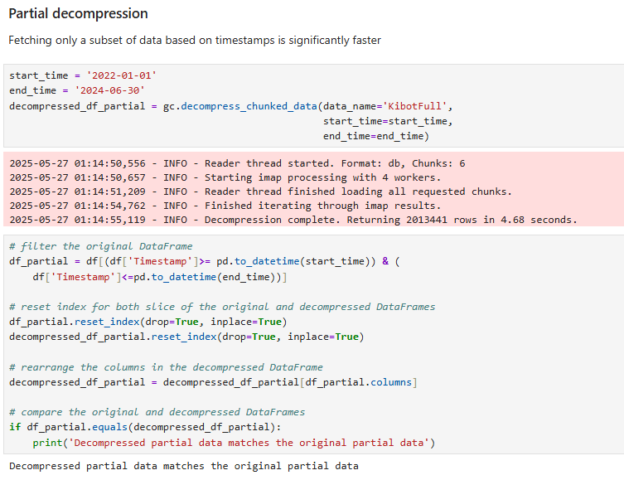

Slide 15
Performance vs TimescaleDB

Slide 16
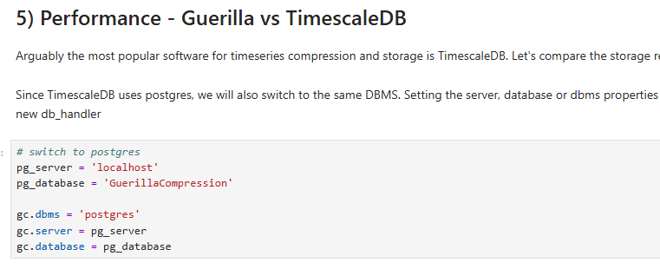
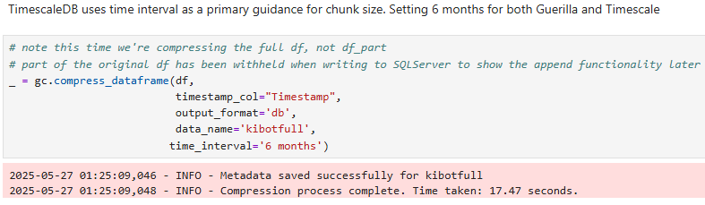

Slide 17
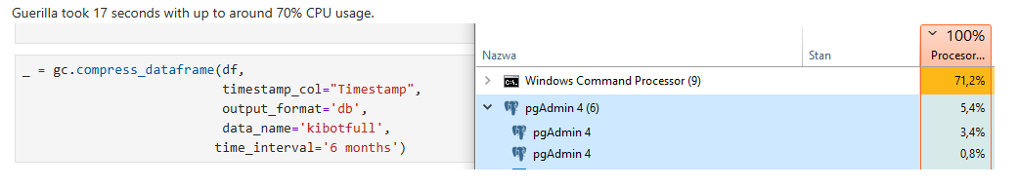
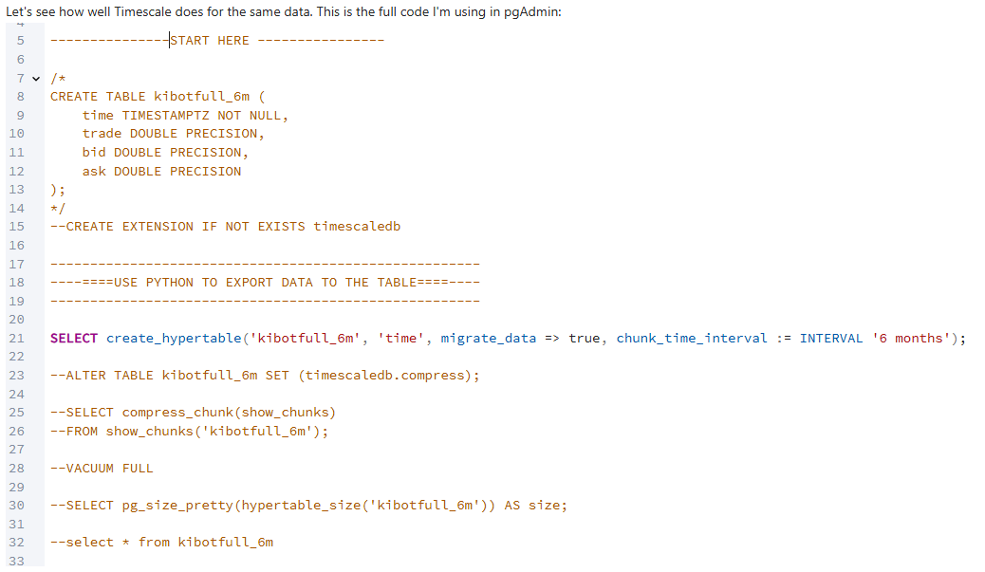

Slide 18
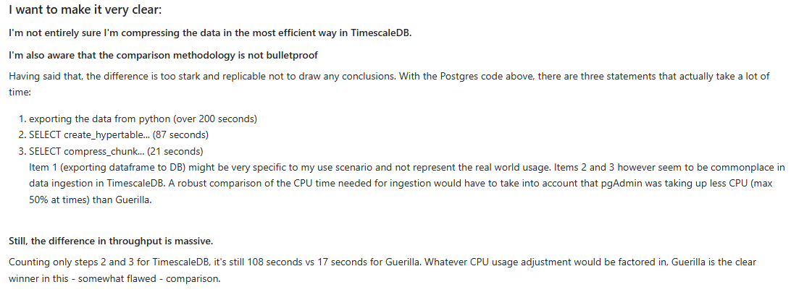
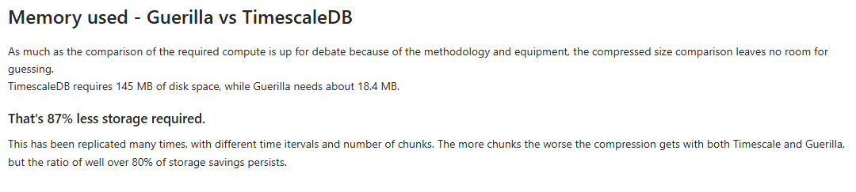

Slide 19
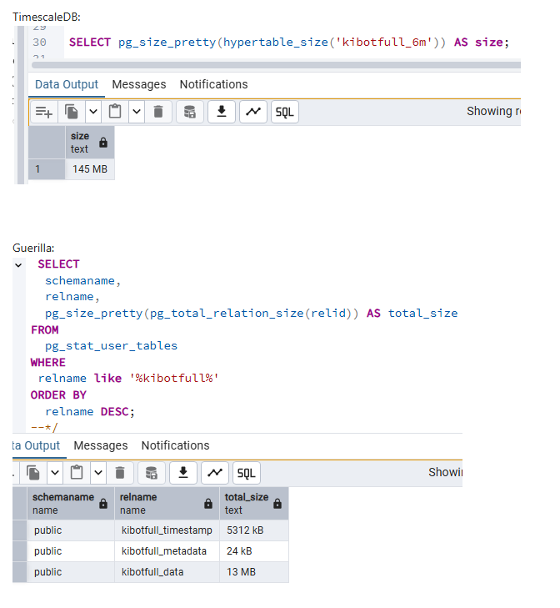



Slide 20
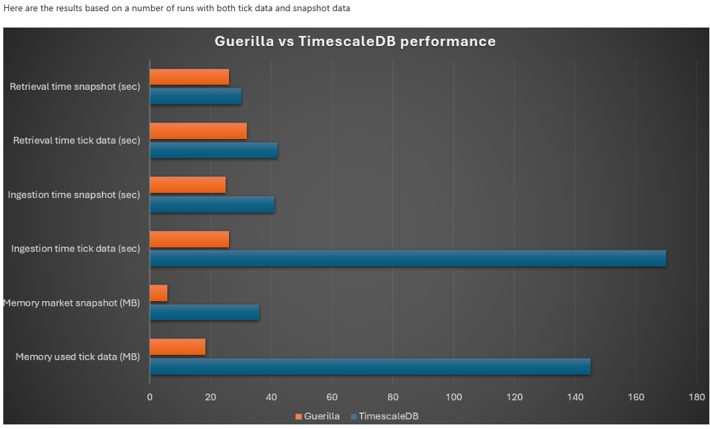

Slide 21
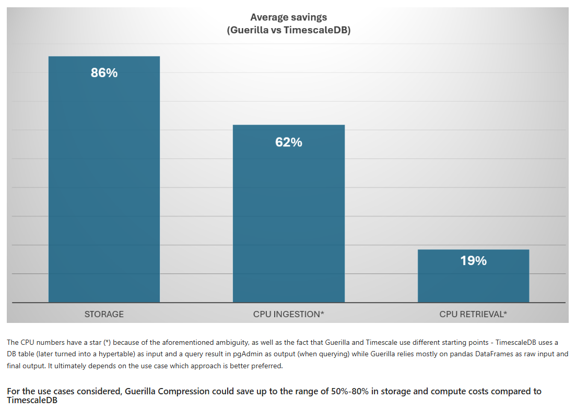

Slide 22
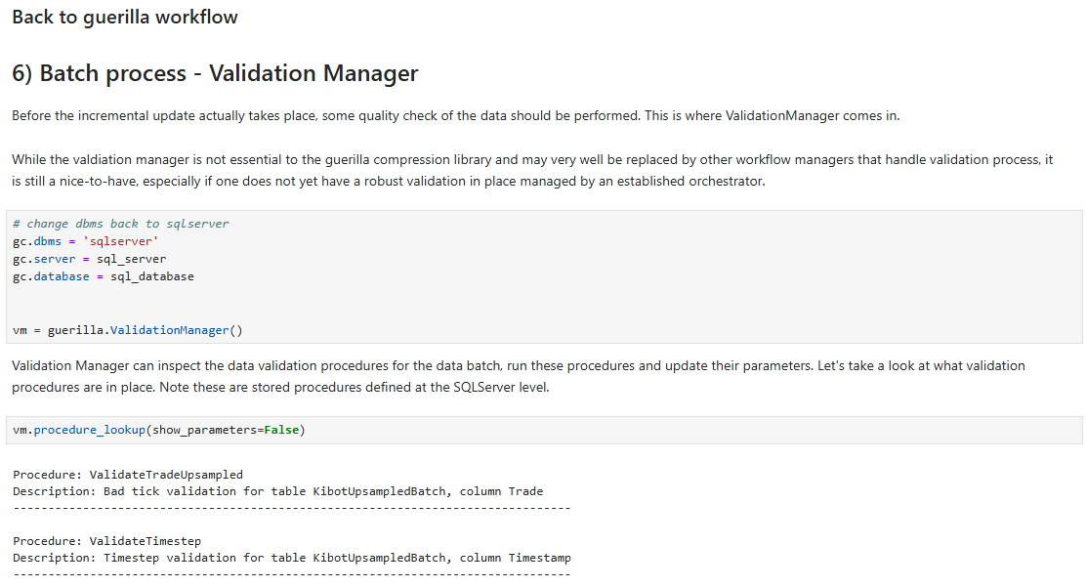

Slide 23
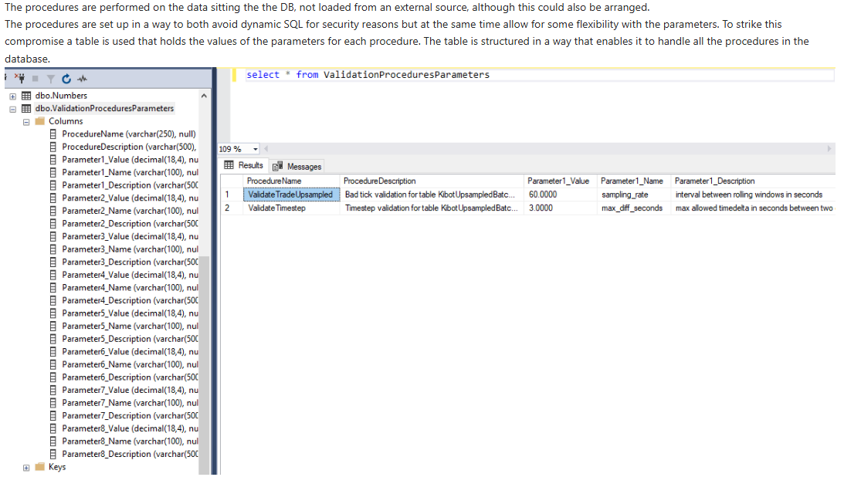

Slide 24
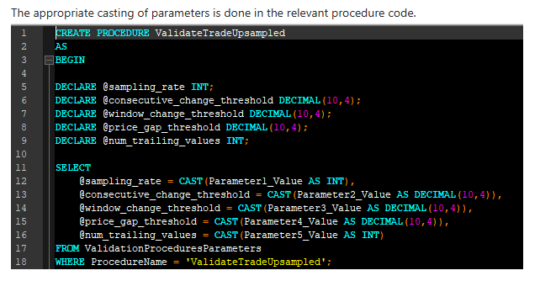

Slide 25
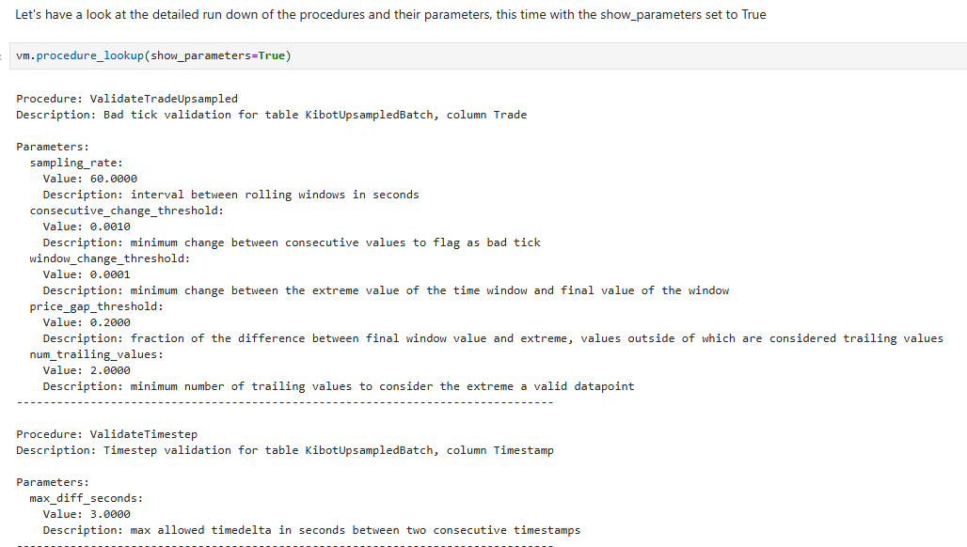

Slide 26
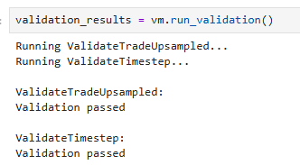
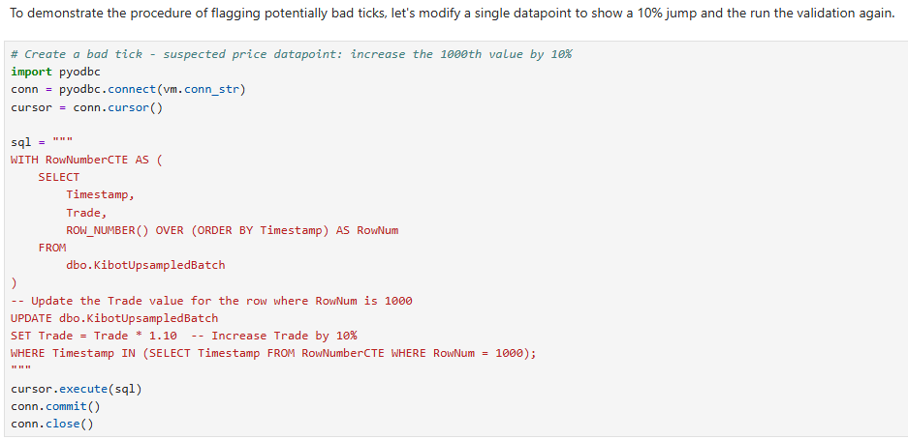

Slide 27
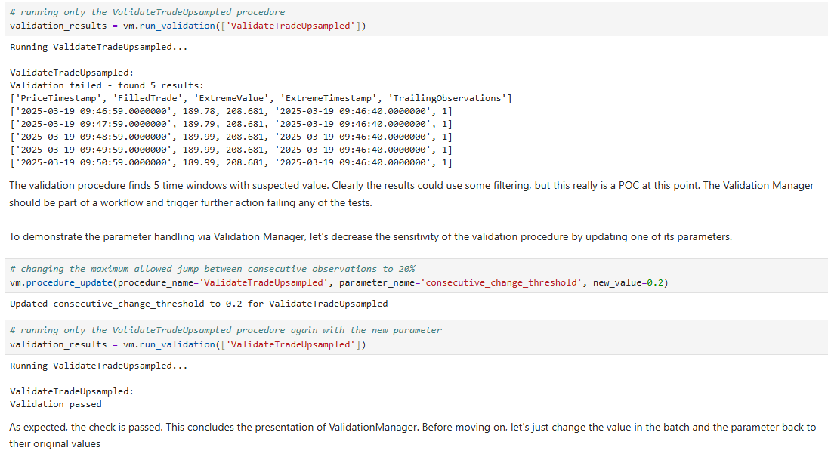

Slide 28
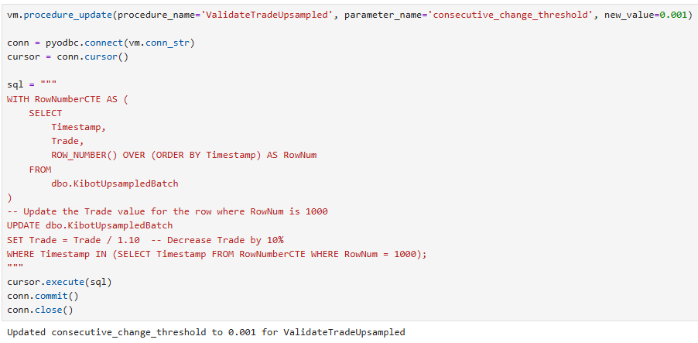

Slide 29
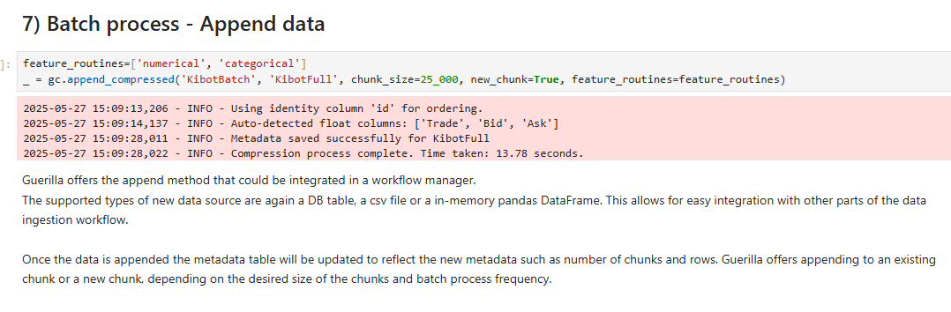

Slide 30
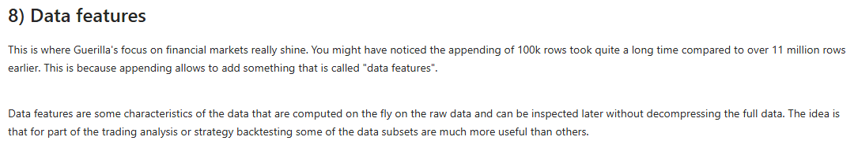
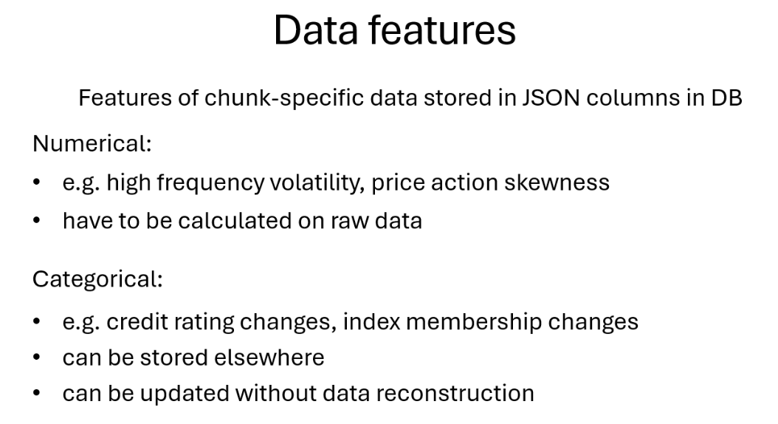

Slide 31
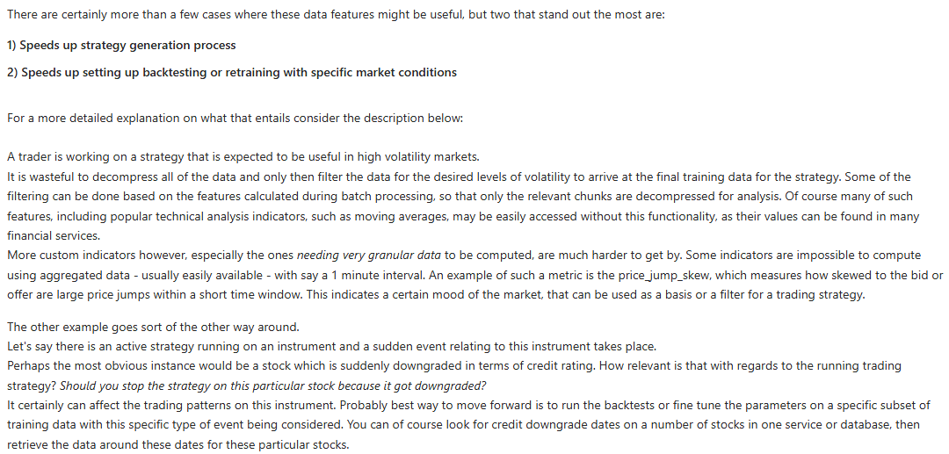

Slide 32
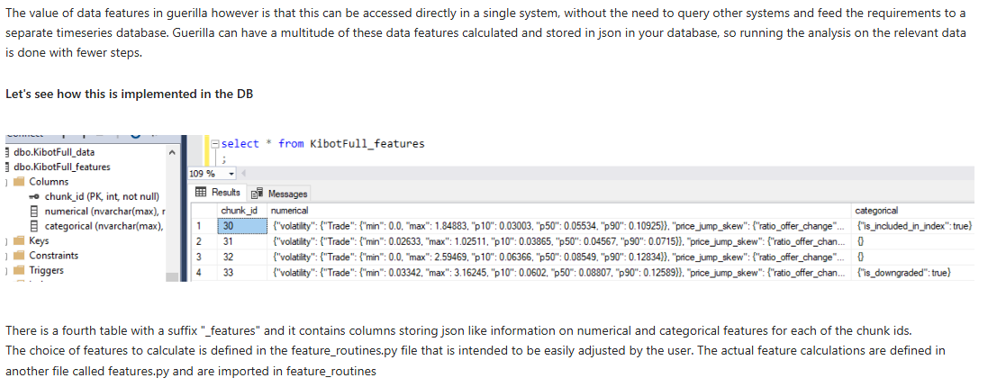
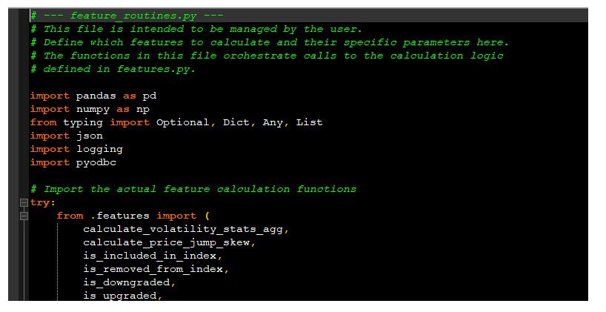

Slide 33
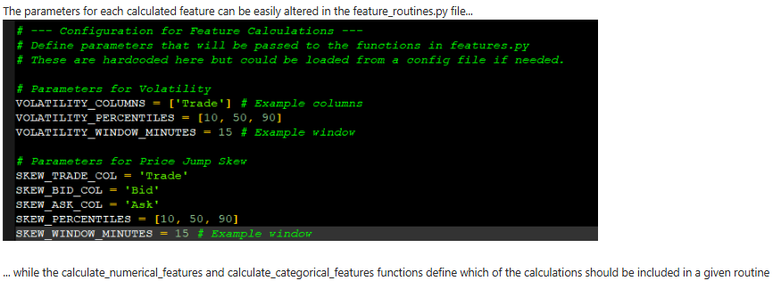
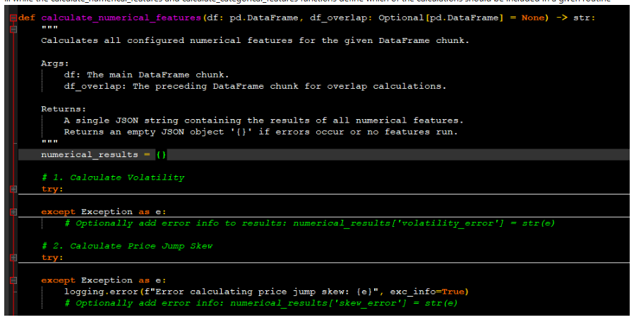

Slide 34
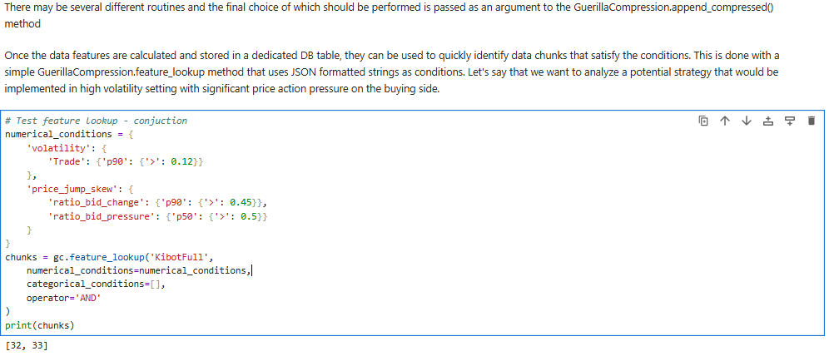

Slide 35
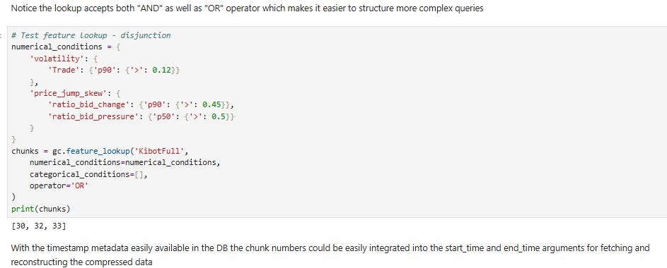

Slide 36
Data features – summary
What this data features functionality does in essence is it shortens the path between an idea or an external trigger and the arriving at an informed data-driven decision and action.
It enables to iterate through ideas with less effort.
With market moods and patterns shifting quickly, this translates into a greater chance of seizing the opportunities before they go away, which can make a substantial difference in terms of overall trading results.

Slide 37
Performance vs other compression algorithms

Slide 38
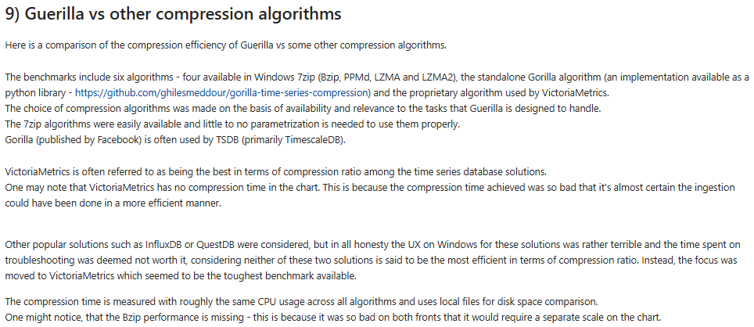

Slide 39
